Slide 1
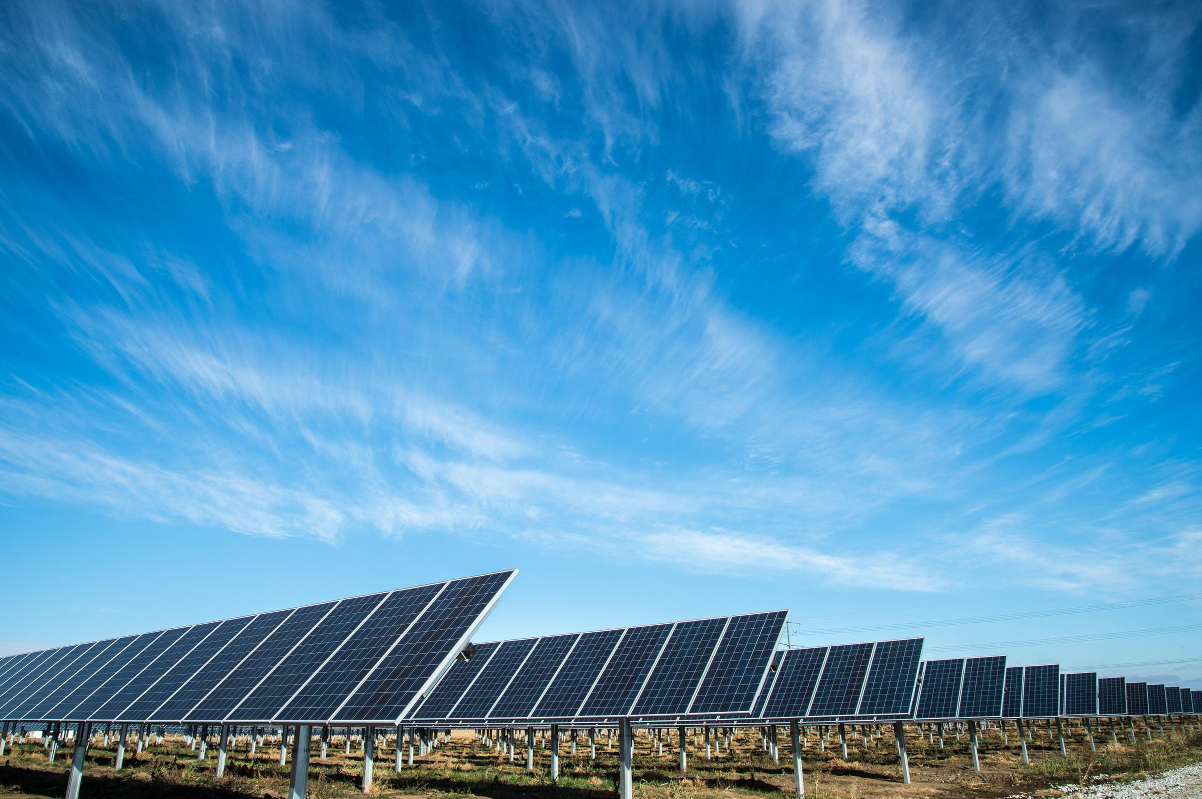
Team Zero
Amin Mansouri
Jefry el Bhwash
Niels van Schaik
Niels van Drunen
Levy Duivenvoorden

Slide 2
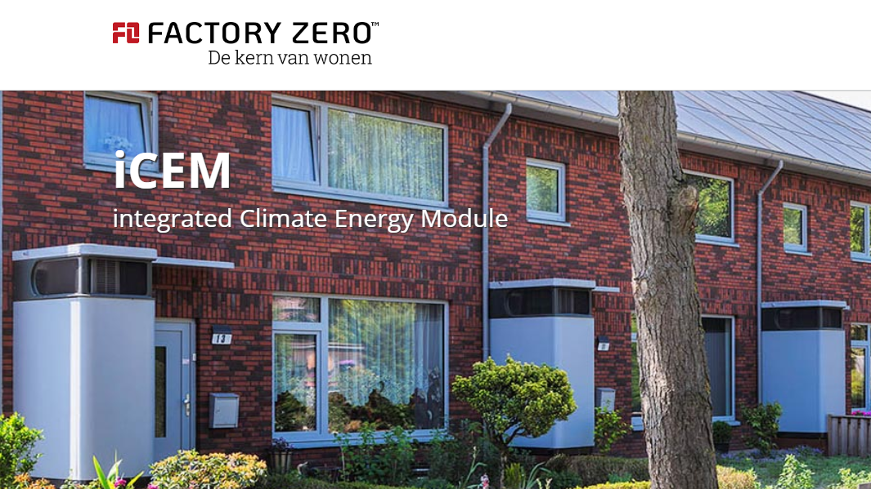
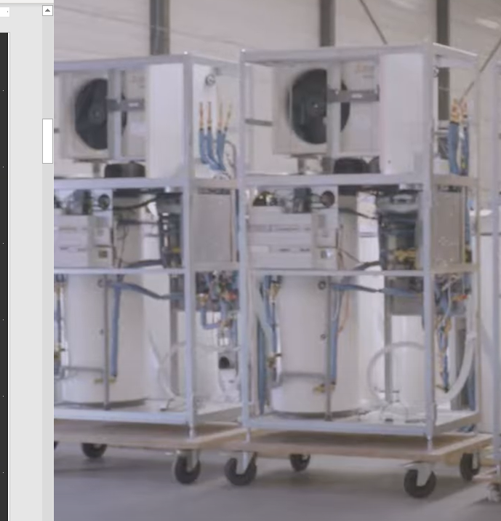
120 houses located in Zoetermeer

Slide 3
Research Question
What is a suitable machine learning model to predict energy use & production of a “zero at the meter” residential house, one day in advance with (if possible) an hourly resolution?

Slide 4
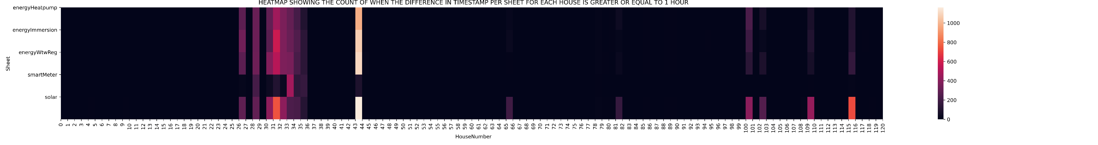
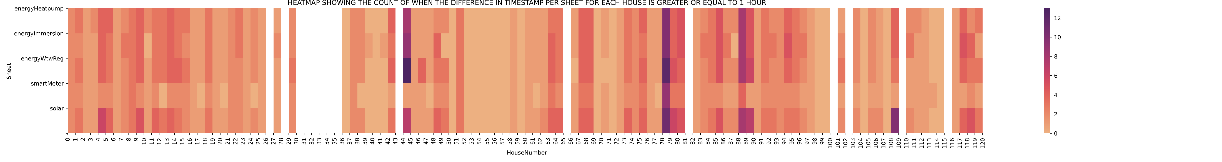
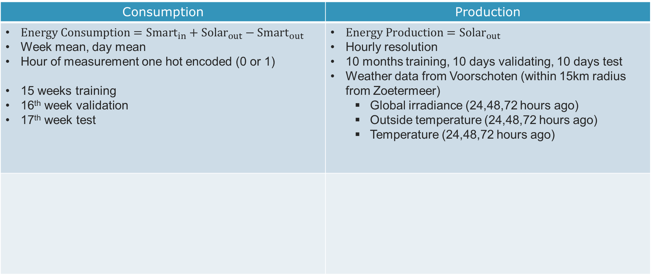
Data Preprocessing
Consumption | Production
$Energy Consumption=Smart_{in}+Solar_{out}−Smart_{out}$ Week mean, day mean Hour of measurement one hot encoded (0 or 1) 15 weeks training 16th week validation 17th week test | $Energy Production=Solar_{out}$ Hourly resolution 10 months training, 10 days validating, 10 days test Weather data from Voorschoten (within 15km radius from Zoetermeer) Global irradiance (24,48,72 hours ago) Outside temperature (24,48,72 hours ago) Temperature (24,48,72 hours ago)

Slide 5
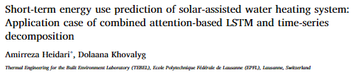
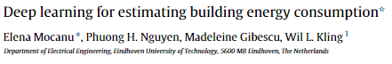
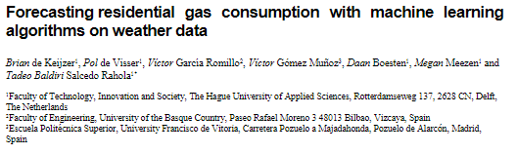
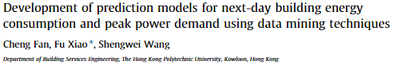

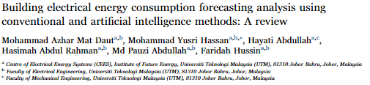
Literature
Models
SVR
MVLR
MLP
LSTM

Slide 6
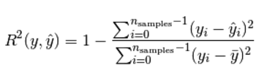
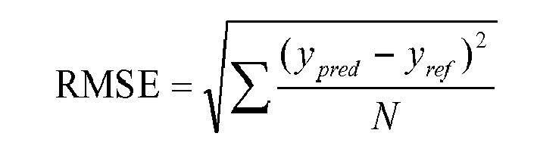
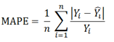
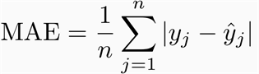
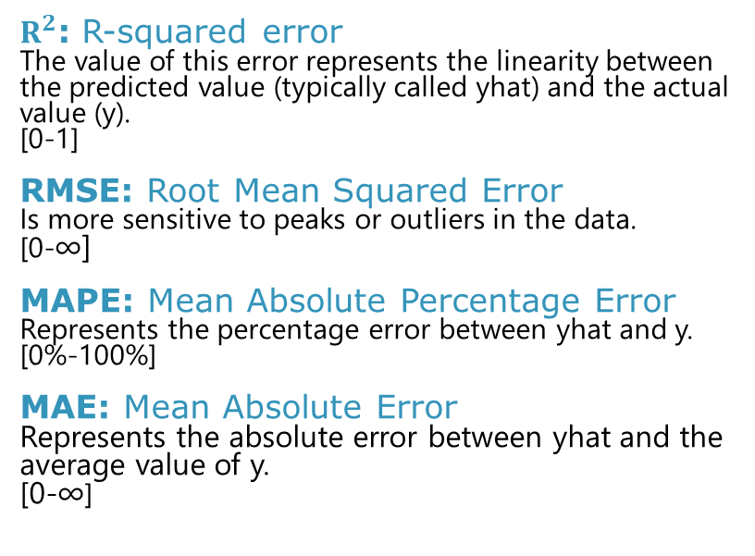
Evaluation Metrics
$R^{2}$: R-squared error The value of this error represents the linearity between the predicted value (typically called yhat) and the actual value (y).
[0-1]
RMSE: Root Mean Squared Error Is more sensitive to peaks or outliers in the data.
[0-∞]
MAPE: Mean Absolute Percentage Error Represents the percentage error between yhat and y. [0%-100%]
MAE: Mean Absolute Error Represents the absolute error between yhat and the average value of y.
[0-∞]
Problems:
MAPE error has trouble with really small values
RSME has difficulity with energy consumption data

Slide 7
Production
Regular patterns

Slide 8
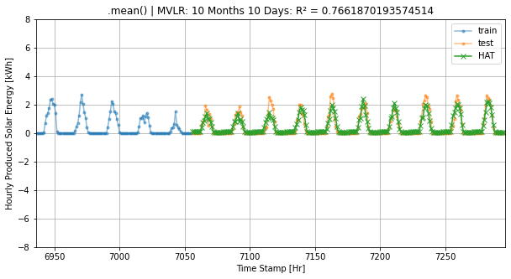
MVLR (Multi Variate Linear Regression – Machine Learning)

Slide 9
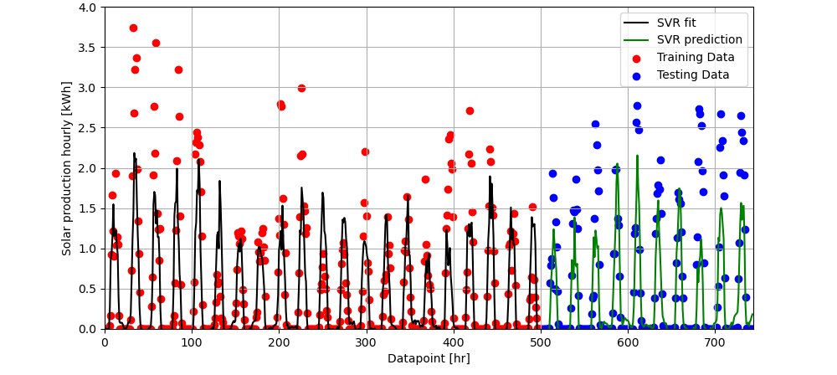
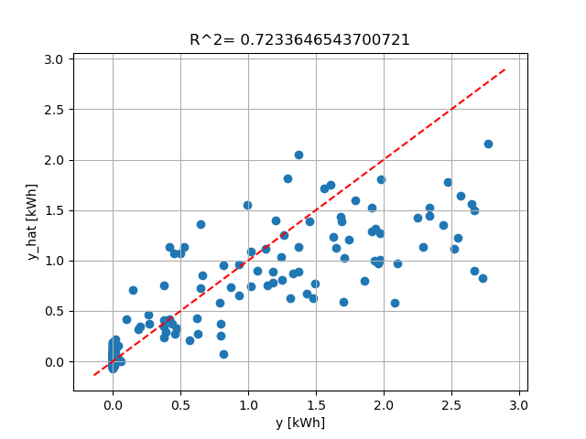
SVR (Support Vector Regression) C-parameter: 1.0

Slide 10
Consumption
Very irragular patterns

Slide 11
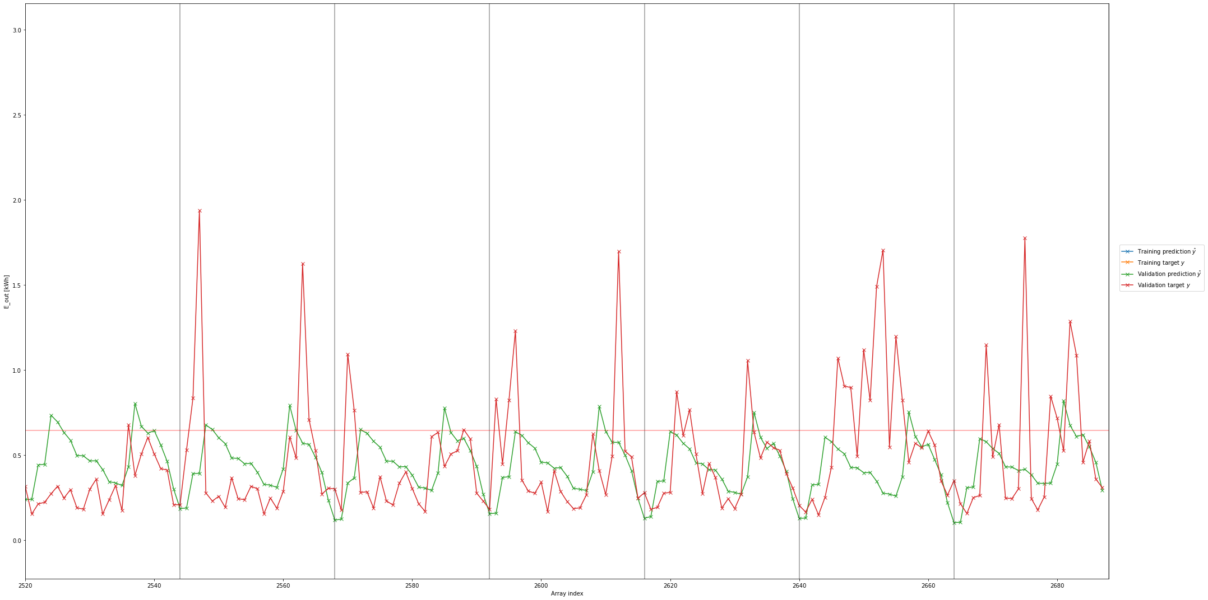
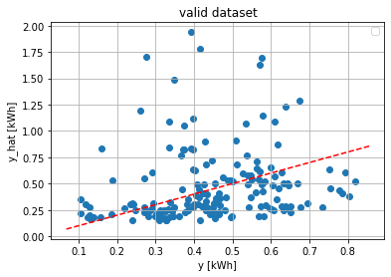
MVLR (Multi Variate Linear Regression – Machine Learning)

Slide 12
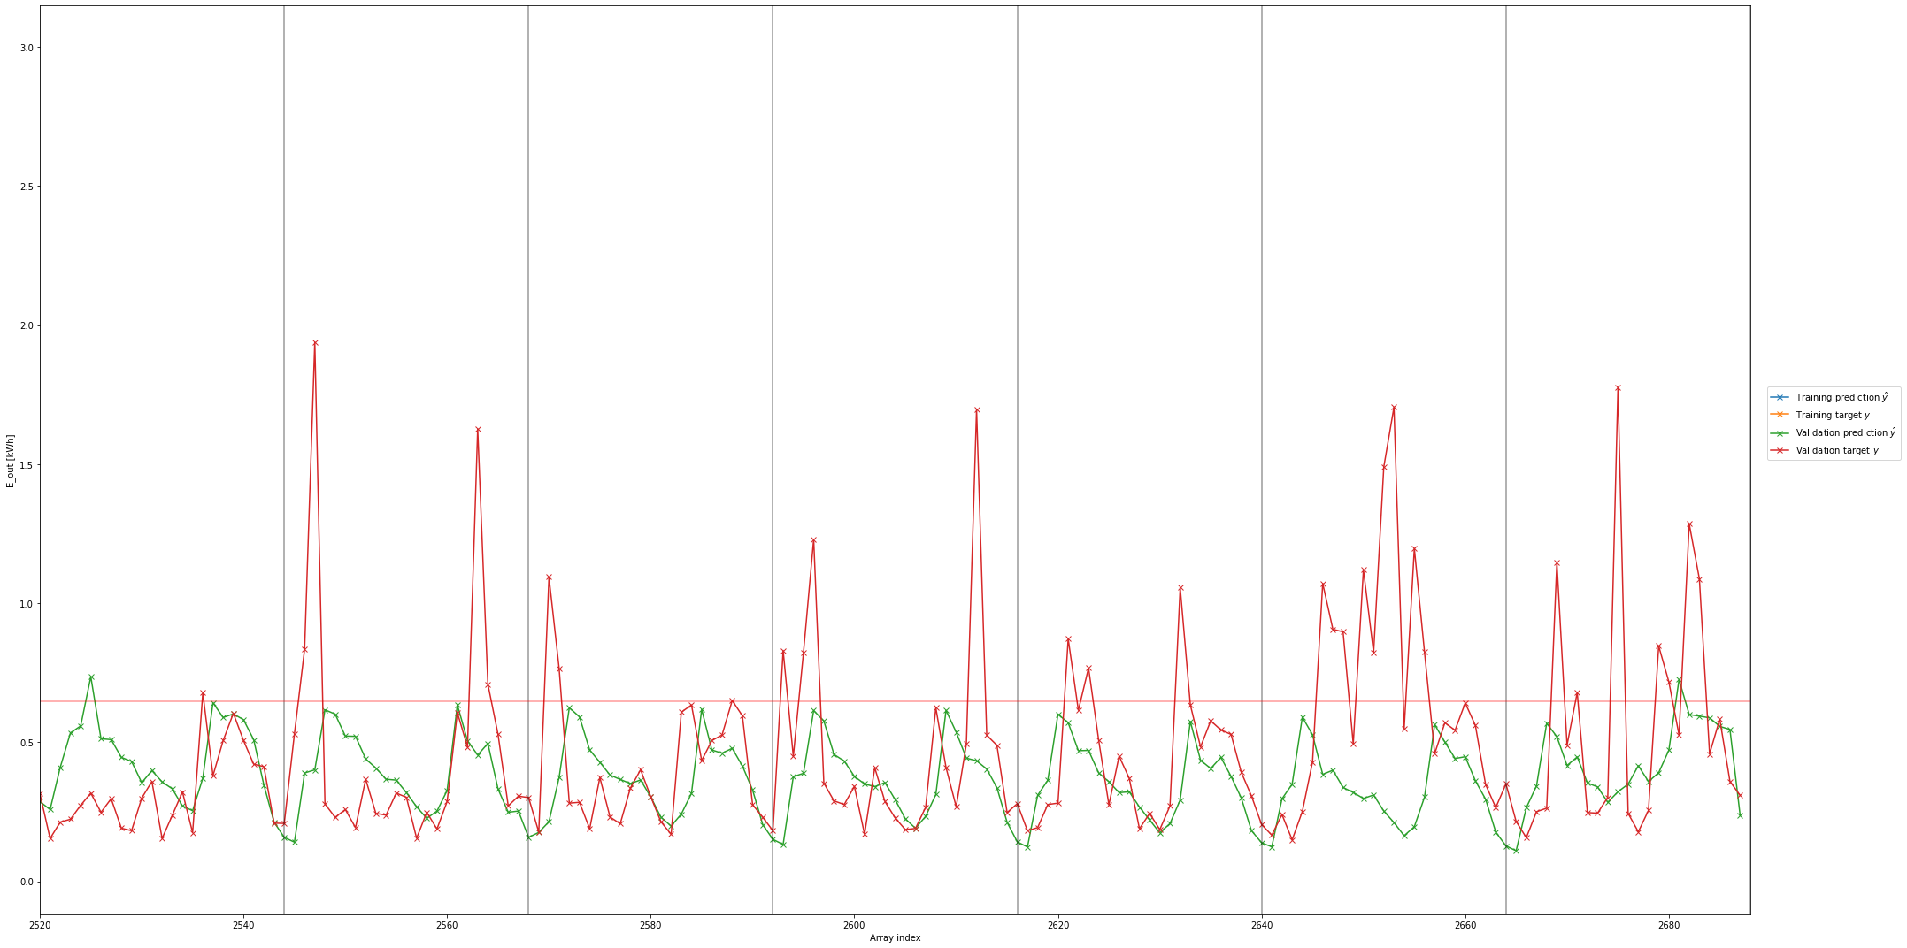
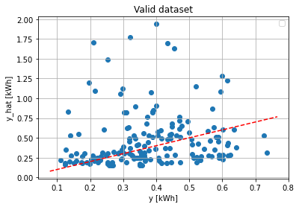
SVR (Support Vector Regression - SVM)
C-parameter: 1.0

Slide 13
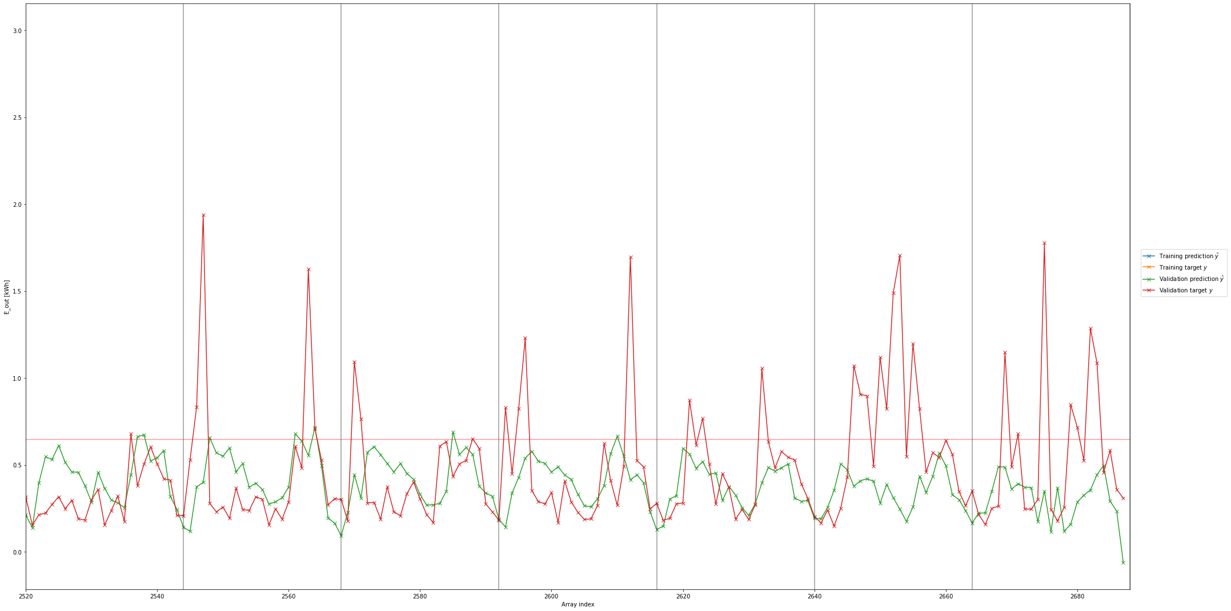
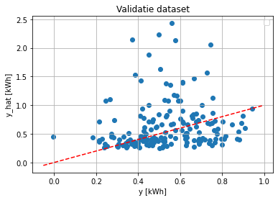
MLP (Multilayer Perceptron - ANN)
2 Linear layers loss function: MSE - loss

Slide 14
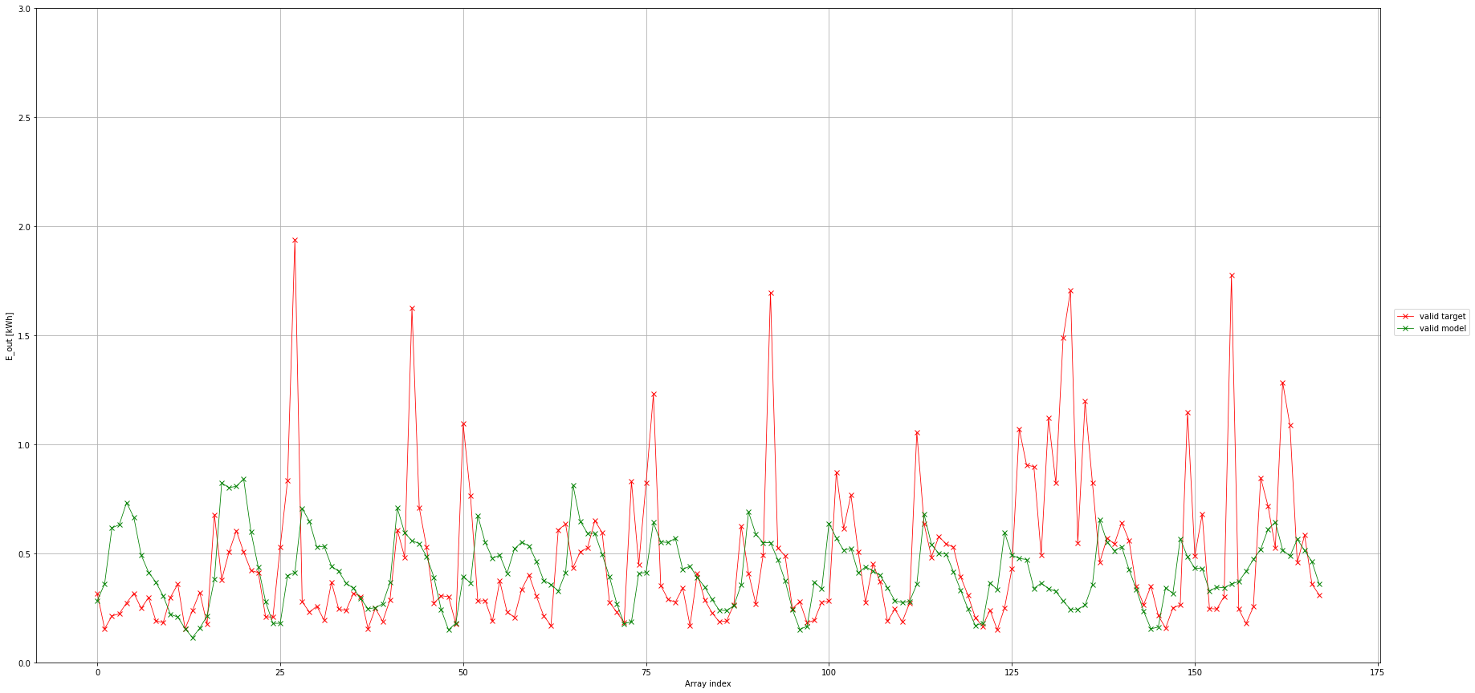
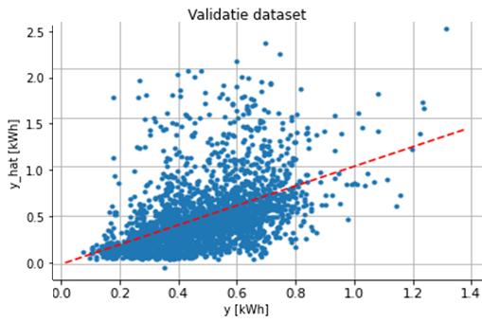
LSTM (Long Short Term Memory - RNN)
2 LSTM cells that feeds in1 linear layer loss function: MSE - loss

Slide 15
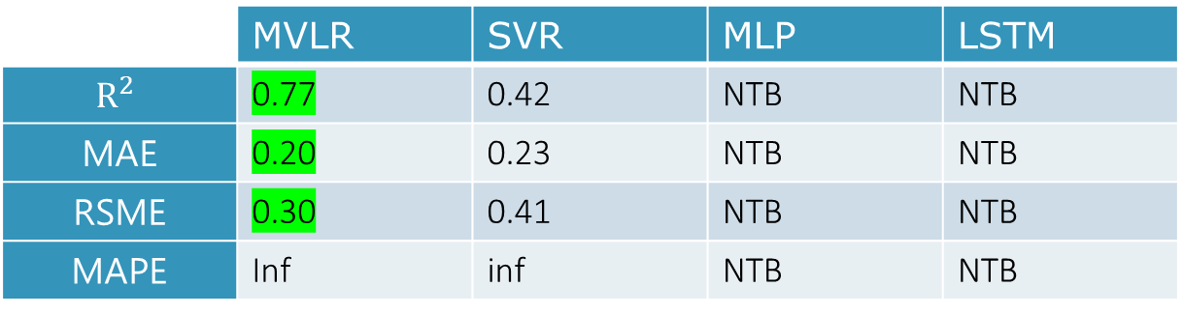
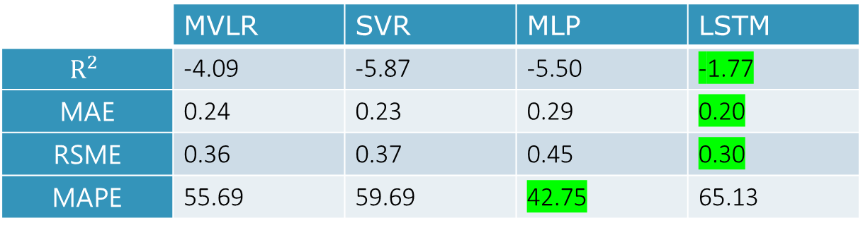
Summary
Energy Production (over validation)
 | MVLR | SVR | MLP | LSTM
$$R^{2}$$ | 0.77 | 0.42 | NTB | NTB
MAE | 0.20 | 0.23 | NTB | NTB
RSME | 0.30 | 0.41 | NTB | NTB
MAPE | Inf | inf | NTB | NTB
LSTM is the best method
Energy Consumption (over validation)
 | MVLR | SVR | MLP | LSTM
$$R^{2}$$ | -4.09 | -5.87 | -5.50 | -1.77
MAE | 0.24 | 0.23 | 0.29 | 0.20
RSME | 0.36 | 0.37 | 0.45 | 0.30
MAPE | 55.69 | 59.69 | 42.75 | 65.13
Green: The best score per score

Slide 16
Future
Create 2 LSTM’s for peak data and non-peak data for energy consumption
Create a similar LSTM for production
Continue to write our paper

Slide 17

Remarks, Suggestions, Questions

Slide 18
Open Questions:
- How much energy does a real zero at the meter house consume?
- Which appliance uses the most energy in the house?
-

